Slide 1
GIT AND GITHUB

Slide 2
Git - Overview
Git was created by Linus Torvalds in 2005
It is a file or code-sharing service to collaborate with different people.
It is a distributed version control system, developed to manage projects with high speed and efficiency.
Its goals include speed, data integrity, and support for distributed, non-linear workflows.
Git can be used privately and publicly.

Slide 3
Features of GIT
Open Source.
Scalable.
Distributed.
Security.
Speed
Supports non-linear development.
Branching and Merging
Data Assurance.
Staging Area.

Slide 4
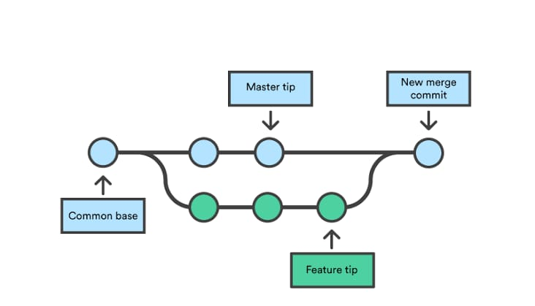
Branching and Merging

Slide 5
Github
Github is a cloud based hosting service that lets us manage Git repositories.
GitHub is designed to help you better manage the open source project that use Git.
GitHub is a code hosting platform for version control and collaboration.

Slide 6
Benefits of Git
Simultaneous development
Faster releases
Built-in integration
Strong community support

Slide 7
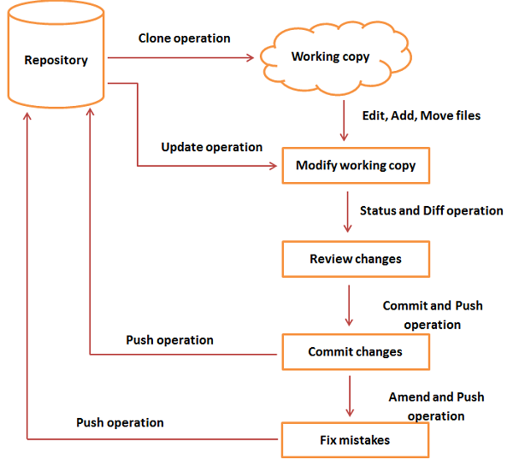
Workflow

Slide 8
General workflow
You clone the Git repository as a working copy.
You modify the working copy by adding/editing files.
If necessary, you also update the working copy by taking other developer's changes.
You review the changes before commit.
You commit changes. If everything is fine, then you push the changes to the repository.
After committing, if you realize something is wrong, then you correct the last commit and push the changes to the repository.

Slide 9
Pull requests in Github
Pull requests let you tell others about changes you've pushed to a branch in a repository on GitHub.
Pull request is created to propose and collaborate on changes to a repository.
These changes are proposed in a branch, which ensures that the master branch only contains finished and approved work.
Once a pull request is sent, interested parties can review the set of changes, discuss potential modifications, and even push follow-up commits if necessary.

Slide 10
Github private repo
File.py
File.py
Github code repo
File.py
Make changes
Github private repo
File.py
File*.py

Slide 11

GitBash
Git Bash is an application for Microsoft Windows environments which provides an emulation layer for a Git command line experience.
Git Bash is not a GUI software, it is a command-line prompt.
Bash is an acronym for Bourne Again Shell.
Git Bash is a package that installs Bash, some common bash utilities, and Git on a Windows operating system.

Slide 12
Git commands in command line
Install Git :
pip install git
To check the version : git –version
Configure Git :
git config --global user.name "your_username“
git config --global user.email "your_email_address@example.com"
To check the configuration : git config --global –list
To copy git repo from git hub
git clone url
Add filename to staging area
git add filename

Slide 13
To commit to database
git commit m
To specify all the commit history
git log
To specify current status of staging area
git status
To push commited changes to github
git push
To show difference between local version and previous version of file
git difftool

Slide 14
To undo uncommitted changes :
git checkout—filename
To undo committed changes and commit to local repo :
git revert(commit id)
To undo committed changes :
git revert -n(commit id)
To reset changes :
git reset --hard(commit id)
To list out all the branches :
git branch

Slide 15
To create new branch :
git branch new_branch_name
To activate the branch :
git checkout branch_name
To create new branch and make it active :
git checkout –b branch_name
To merge the specified branch with active branch :
git merge branch_name
To delete the branch :
git branch -d branch name

Slide 16
Local Computer
Remote Server (github)
Version database
Ex1 v1
def sum(a,b):
return a+b
git push
Ex1 v1
def sum(a,b):
return a+b
git commit
Working copy
Staging area
Ex1
def sum(a,b):
return a+b
Ex1
def sum(a,b):
return a+b
git add

